Slide 1
Proctoring
Research Work

Slide 2
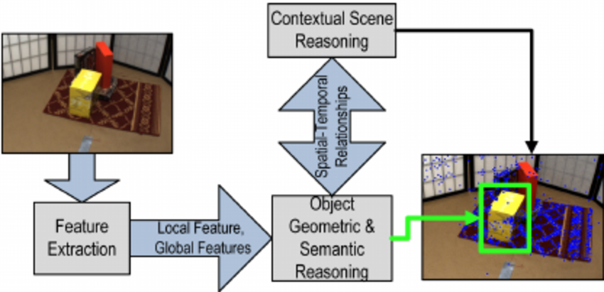
Face Detection Packages
AForge.Net => Computer Vision and Artificial Intelligence.
EmguCV => Image Processing Library.

Slide 3
USB Port Detection
USB:
  using System.Runtime.InteropServices;
  https://www.codeguru.com/dotnet/detecting-usb-devices-using-c/

Slide 4
IP Address and VPN Detection
Use GetAdaptersAddresses instead of gethostbyname. I believe IP_ADAPTER_ADDRESSES::IfType would be IF_TYPE_ETHERNET_CSMACD for "real" network card and IF_TYPE_TUNNEL for VPN.
https://www.c-sharpcorner.com/blogs/how-to-get-mac-address-of-client-machine-in-asp-net-c-sharp

Slide 5
Resizing The Window
Class:
PictureBox
ClientRectangle
Control
Attributes: Display, Height Width etc.
https://stackoverflow.com/questions/7942939/getting-the-size-of-a-windows-form

Slide 6
Thank
You

